Slide 1
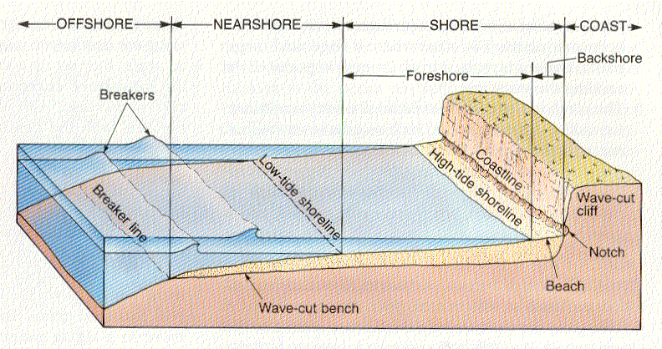
Coastal Geology
Erosional Shore Features

Slide 2
Erosional Shore Features
Shore = the zone that lies between low tide and the highest elevation
that is affected by storm waves.
Coast = the zone from the highest elevation of the shore inland as far as
features that seem to be related to marine processes occur.
Flooding and high winds are examples.
Coastline = The dividing line between the shore and the coast. It’s a
line connecting the highest points affected by storm waves.
The shore is divided into….
Foreshore = is exposed at low tide and
submerged at high tide.
Backshore = extends from the normal high tide to the
coastline.

Slide 3
Wave cut bench = smooth area cut into bedrock by wave erosion.
Beach = deposits that move along the wave cut bench.
Wave cut cliff = a cliff formed by wave action cutting away a notch
at its base.

Slide 4
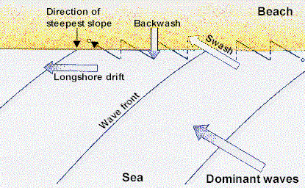
Longshore current = a movement of water that is the result of waves
striking the shore at an angle.
Swash = water moving sediment onto the exposed beach at an angle.
Backwash = gravity carrying the water and sediment of the swash
straight down the beach.
Longshore drift = the movement of sediment by the longshore current.

Slide 5
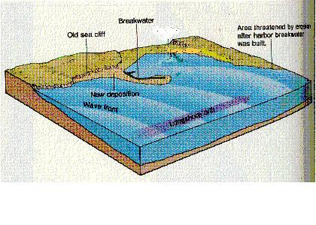
The amount of longshore drift is determined by an equilibrium between erosional and depositional forces. Any interference will destroy this equilibrium.
Examples of such interferences are as follows (ie. breakwater, jetty, groin, sea wall.
Breakwater
The purpose of the breakwater is to prevent waves from entering into a harbor. It causes the area
down current to
erode at an increased
rate.
A breakwater runs parallel to the shore creating a “safe” harbor and interfering with the LSD.
In the area directly upcurrent, an area of sand deposition will occur.

Slide 6
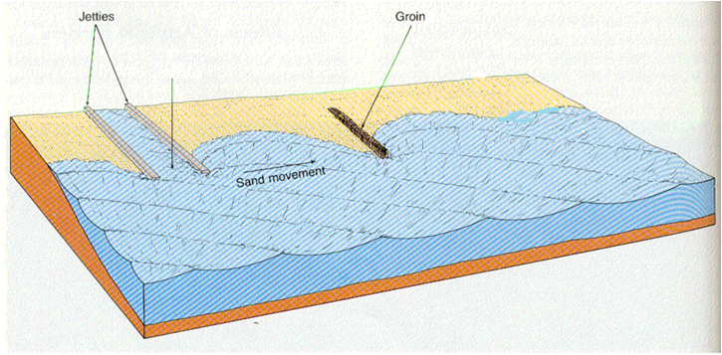
Jetties and
Groins
Inlet
Jetties interfere with the long shore drift and dissipate wave energy. They run perpendicular to the shore and work in pairs. They are built to keep an inlet open. Jetties cause the area of sand deposition upcurrent while the area down current erodes at an increased rate. Jetties are longer and less permeable than groins.
Groins are perpendicular to the shore and built to impede the longshore-drift, resulting in
an area of increased deposition upcurrent (building a beach where there was none before)
with an area of erosion downcurrent.
Groins are much shorter than jetties and because they are more permeable than jetties, they
eventually allow sand to migrate around their ends and re-enter the longshore drift
before excessive erosion occurs. They also dissipate wave energy.

Slide 7
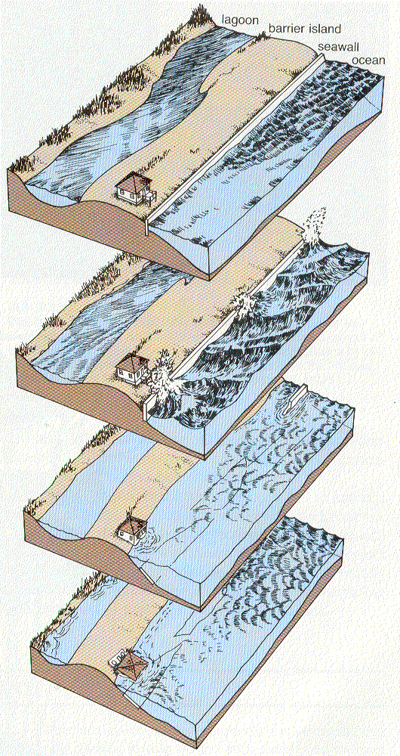
Seawall
The seawalls purpose is to protect structures from storm waves. It actually increases the rate of erosion by concentrating the force of the waves (energy) at the base of the seawall.
The end result is that the
seawall falls into the ocean along with the property it was designed to protect!

Slide 8
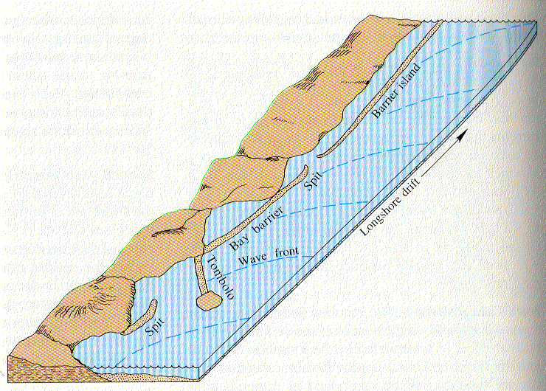
Special Geomorphic Features
Spit = A linear ridge of sediment attached at one end to land. A spit is
an extension of a beach into deeper water near the mouth of a bay.
Spits curve into the bay
Bay Barrier = If the spit extends across the bay to the mainland, then
it is a bay barrier.
Tombolo = a sand ridge that connects an island to another island or a
mainland.
Barrier Island = deposits of sand that lay parallel to the coast.

Slide 9
The typical barrier island has the following characteristics:
Ocean beach = the beach on the ocean side of a barrier island.
Dune = a hill of sand created when winds blow sand inland during dry
periods. It is stabilized by dune grasses. It is the estuaries’
primary protection against flooding.
Barrier flat = located behind the dunes. Forms from the deposition of
sand driven through passes during storms. Typically
colonized by grasses. If frequency of flooding decreases
thickets, woodlands, and forests may move in.
Salt marsh = located behind the barrier flat. Affected by the ebb and
flow of the salt water. A difficult environment for
non-adapted plants or animals to survive in.

Slide 10
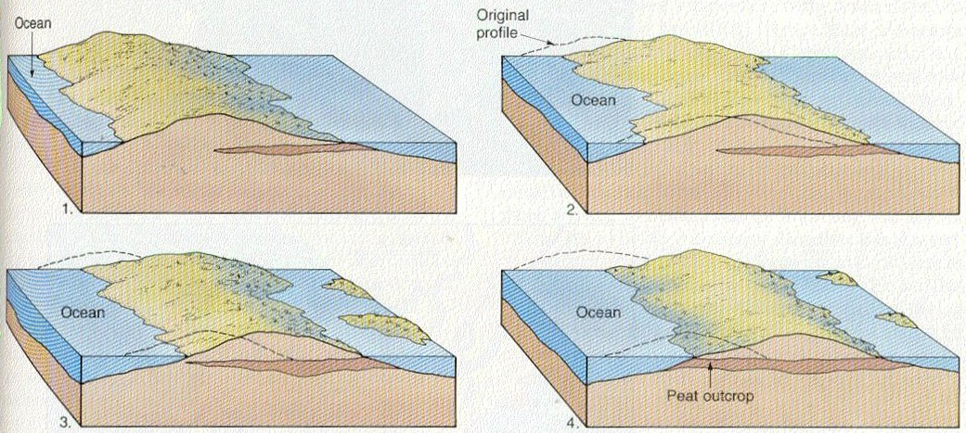
New marsh is formed as overwash (flooding) carries sediment into the
lagoon.
Because of a gradual rise in sea level, barrier islands are migrating
landward.

