Slide 1
Natural Capital and Sustainability

Slide 2
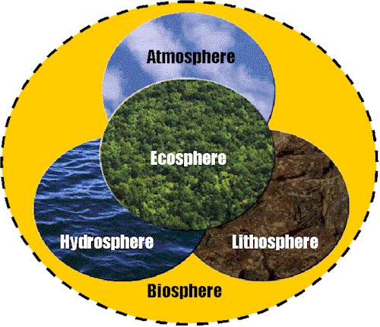
Natural Capital
includes the core and crust of the earth, the biosphere itself - teaming with forests, grasslands, wetlands, tundra, kelp forests, deserts, and other ecosystems - and the upper layers of the atmosphere.

Slide 3
Natural capital & income
The stock is the present accumulated quantity of natural capital. It is a supply accumulated for future use; a store.
The natural income is any sustainable yield or rate of harvest from the stocks.
Natural capital is the term used for ‘natural resources’ which can be exploited to produce natural income of goods and services.
e.g. trees as timber that can be harvested and sold for money.

Slide 4
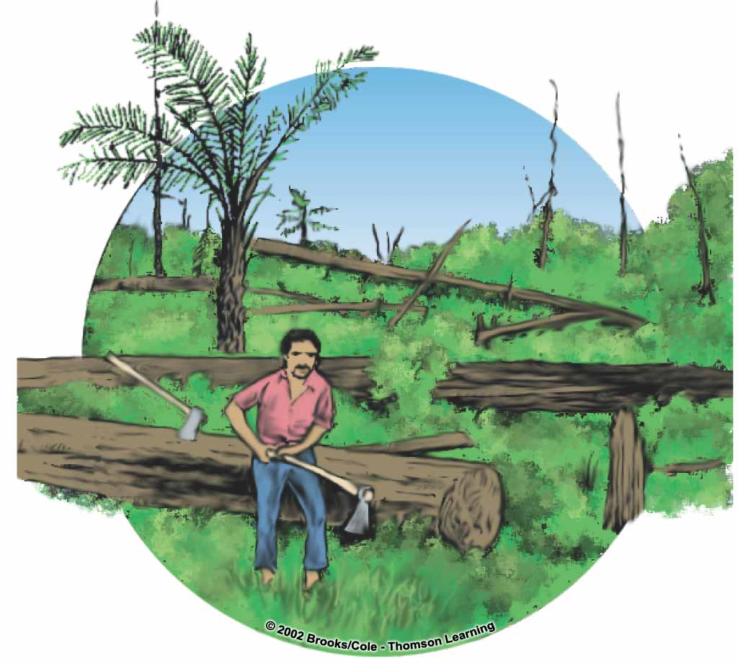
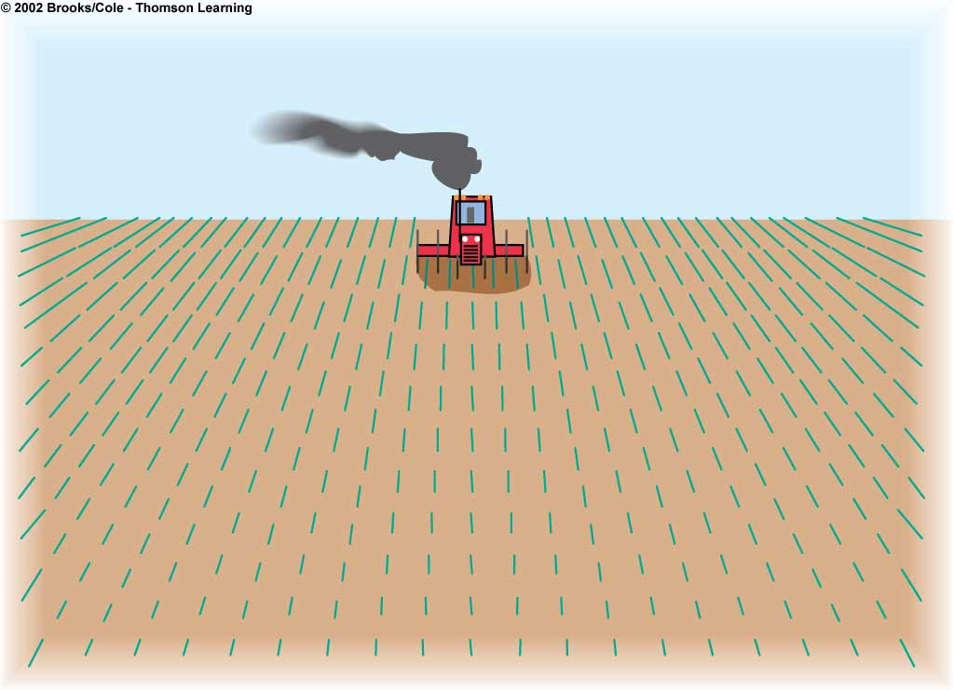
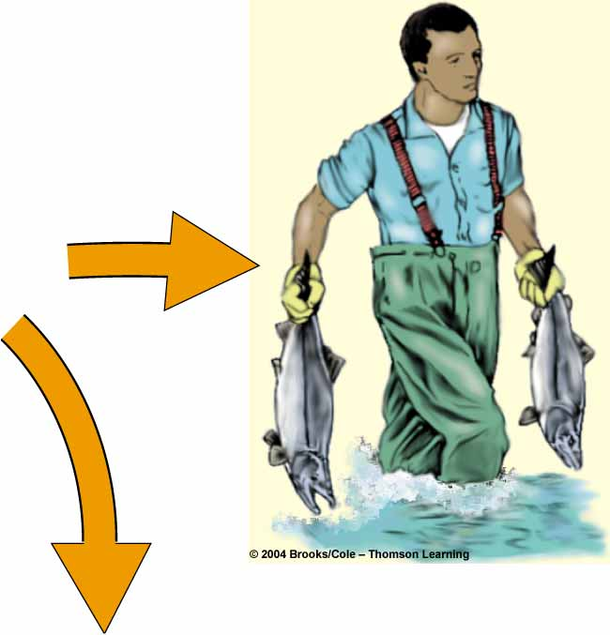
Natural capital provides a wide variety of valuable ecosystem services including flood control, climate stabilization, maintenance of soil fertility, and even beauty and play.
Globally, and within the bioregion, natural capital is being depleted through over-harvesting, development, poor agricultural practices, toxic contamination, and other causes.
Human capture

Slide 5
3 TYPES OF NATURAL CAPITAL
Replenishable (perpetual) -non-living resources which can be continuously restored by natural processes as fast as they are used (e.g stratospheric ozone layer, groundwater).
Renewable - living species and ecosystems which can be replaced by natural productivity (photosynthesis!) as fast as they are used (e.g. food crops, timber).

Slide 6
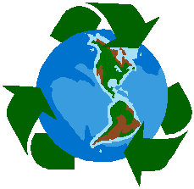
3. Non-renewable - Resources which cannot be replenished at the same rate at which they were used.
Any use of these resources implies depletion of the stock.
e.g. fossil fuels, minerals.
If these resources are being depleted we must:
1) improve efficiency of use 2) develop substitutes or 3) recycle

Slide 7
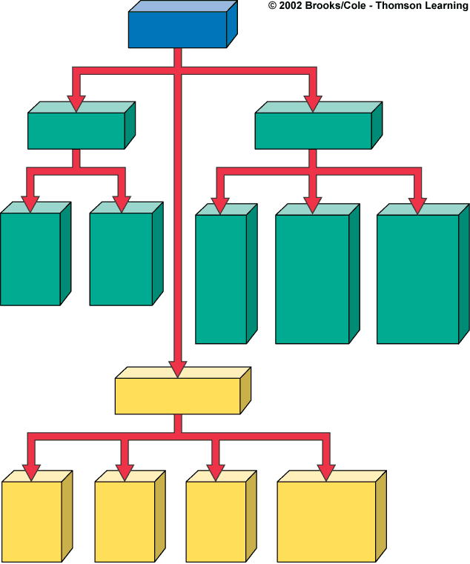
Resources
Perpetual
Nonrenewable
Winds,
tides,
flowing
water
Fossil
fuels
Metallic
minerals
Non-
metallic
minerals
Direct
solar
energy
(iron,
copper,
aluminum)
(clay,
sand,
phosphates)
Renewable
Fresh
air
Fresh
water
Fertile
soil
Plants and
animals
(biodiversity)

Slide 8
And then there is… SUSTAINABILITY!

Slide 9
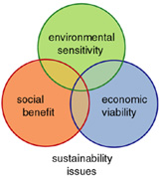
Sustainability
Development that meets the needs of the present without compromising the ability of future generations to meet their needs.
Sustainability is the extent to which a given interaction with the environment exploits and uses the NATURAL INCOME without causing long term deterioration of NATURAL CAPITAL.

Slide 10
Values of natural capital
Economic value: can be determined from the market price of the goods and services it produces.
Ecological value: have no formal market price. Photosynthesis, nitrogen-fixation, soil erosion control are essential for human existence, but are taken for granted.

Slide 11
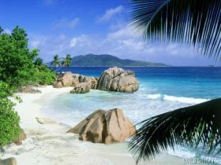
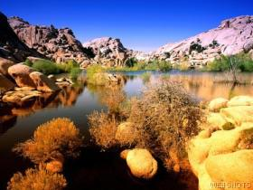
Aesthetic value: have no market price and may not provide identifiable commodities, so they are unpriced or undervalued from an economic viewpoint.

Slide 12
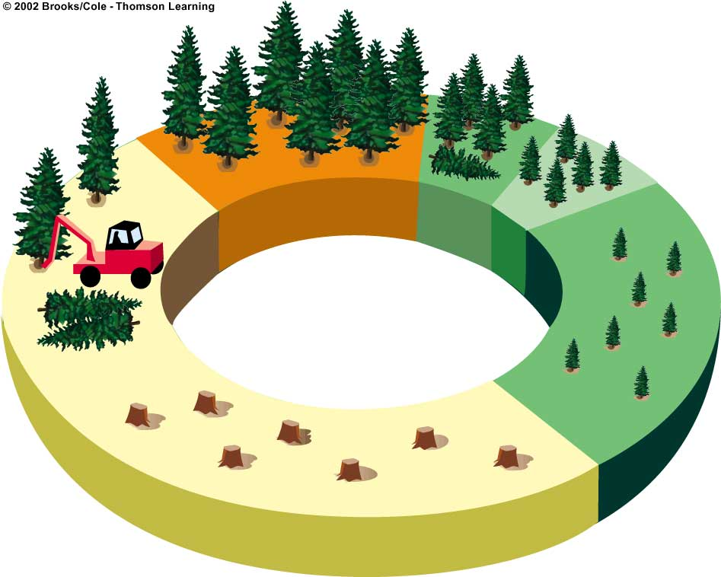
Healthy ecosystems make very significant economic contributions, but often in ways that transcend conventional accounting.
In order to maintain Natural Capital and the services that it provides, the physical basis for the productivity and diversity of nature must not be systematically deteriorated.
Weak trees
removed
Clear cut
Seedlings
planted
25
15
30
Years of growth
10
5

Slide 13
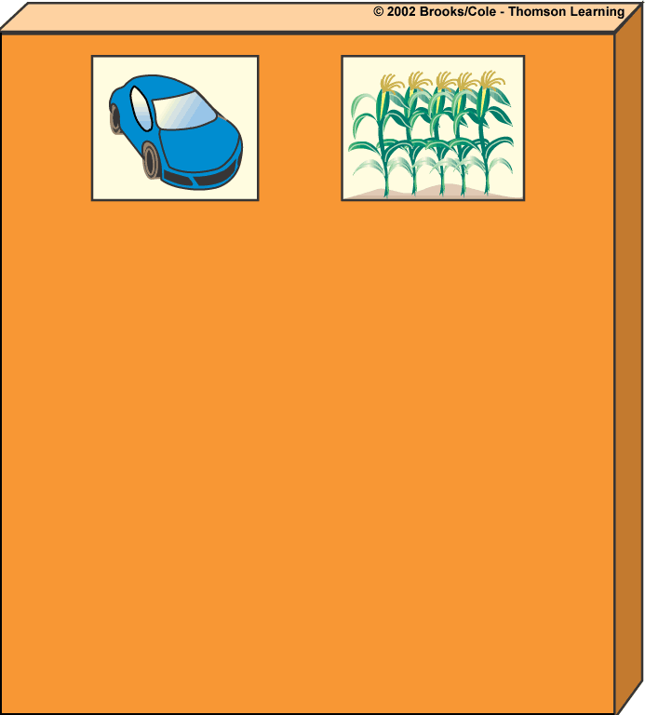
Environmentalists have identified 5 basic causes of environmental problems we face.
Rapid population growth
Unsustainable resource use
Poverty
Not including the environmental costs of economic goods and services in their market prices
Trying to manage and simplify nature with too little knowledge about how it works

Slide 14
Through out this course you have seen that human’s are not managing the world’s resources sustainably:
World’s population has grown to over 7 billion.
We’ve lost about ¼ of the world’s topsoil.
We are feeding well over twice as many people on only 80% of the agricultural fields than were being cultivated in 1950.
Global warming is underway.
Depletion of the stratospheric ozone layer.
Since1950 we have cut down about 1/3 of the forests without replacing them
We are driving the world’s species to extinction.

Slide 15
Sustainable Yield
Sustainable Yield = the Rate of Natural Increase.
SY = total biomass at time 2 – total biomass at time 1
or
energy at time 2 – energy at time 1
Gain in biomass over time through growth and recruitment (addition of individuals to the population).
Can express as energy rather than biomass.

Slide 16
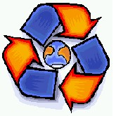
Even with the use of the best technologies we could imagine, the productivity of Earth still has its limits, and the extent of our use of it cannot be expanded indefinitely.
The world does not contain nearly enough resources to sustain everyone at the level of consumption that is enjoyed in the U.S., Europe and Japan.

Slide 17
